Slide 1
Shopping App
Aleksandar Hadzhiev
Felix Morenc

Slide 2

Agenda
Scenario
Research
Demo

Slide 3
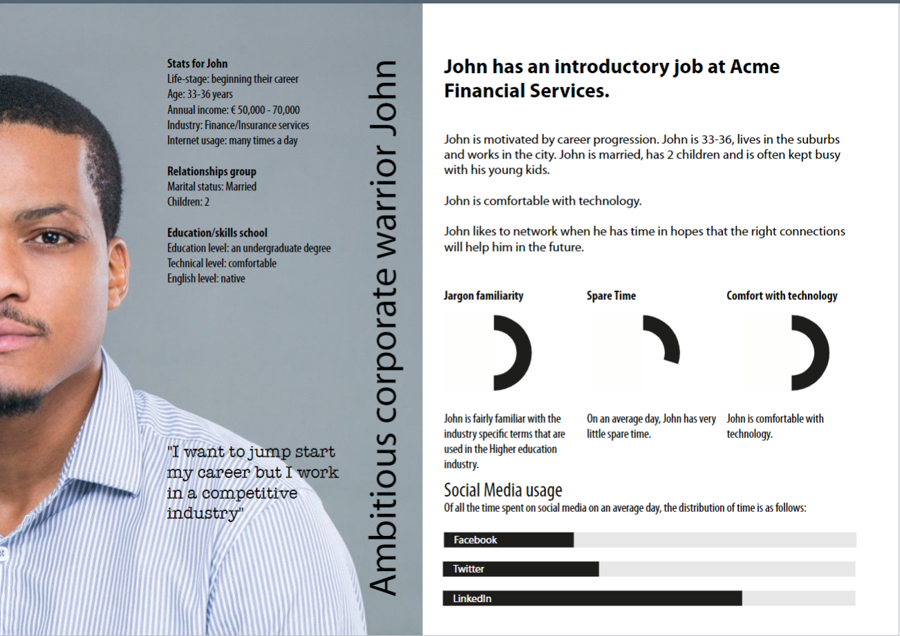
Scenario
John
33 years old
Job oriented
Family with 2 children
Struggling to balance work and family

Slide 4
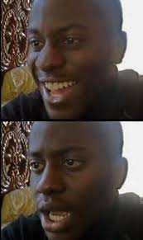

Scenario
John arrives to work
John notices that there is a small tear on his shirt
John needs a solution to his problem

Slide 5



Scenario
Start the application
Find the clothing you like
Easy purchase

Slide 6
Research
Research about the users and their preferences
Research was done into the color preferences of different genders
Research about preferable functionalities
We asked some of our fellow students for feedback
We had feedback meetings with our teachers

Slide 7
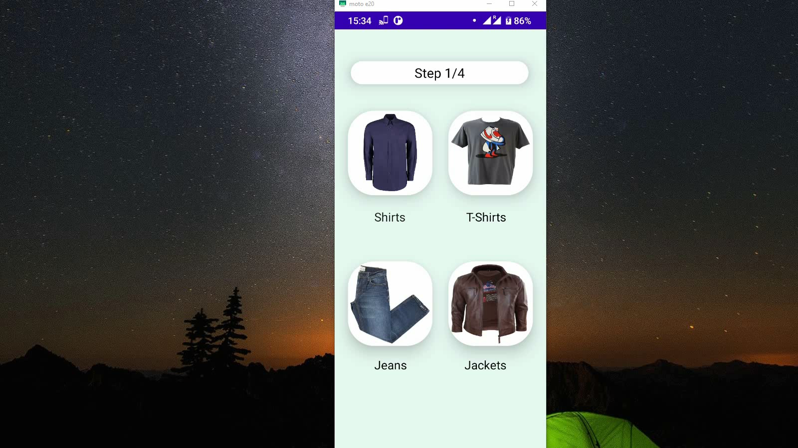
Demo

Slide 8

Thank you

